Slide 1



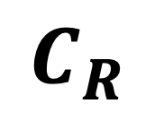
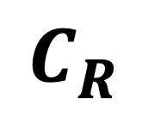

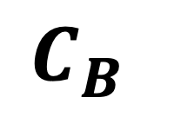
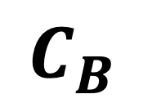

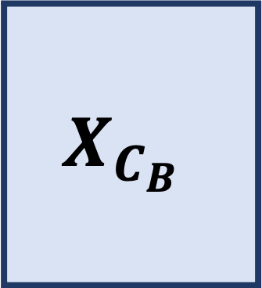





$$Y$$
$$Y$$
Original Image
Color Space Transform
Chroma subsampling
Patchify
$$C_{B}$$
$$C_{R}$$
$$C_{B}$$
$$C_{R}$$
Flatten and Stack Patches
Components
Encoded Image
$$U_{Y}$$
T
$$X_{Y}$$
0
1
0
0
1
.
.
.
$$U_{C_{B}}$$
$$X_{C_{B}}$$
T
$$V_{C_{B}}$$
Lossless Image Compression
Reshape Factors
$$V_{Y}$$
Integer Matrix Factorization
Coefficients
T
$$X_{C_{R}}$$
$$U_{C_{R}}$$
$$V_{C_{R}}$$

